Slide 1
Device Status LED Display for Library Tech Lending
sddec20_02

Slide 2
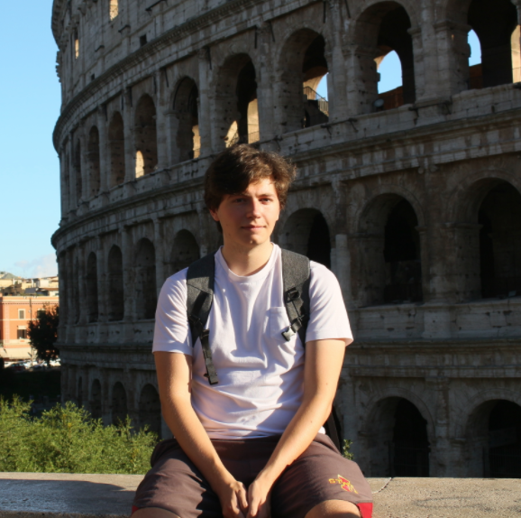
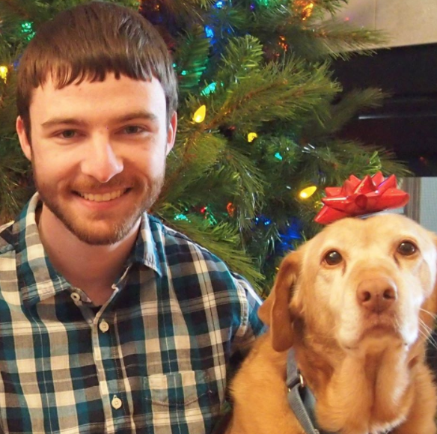
The Team
Aaron Thune
Computer Engineering
John Wagner
Computer Engineering
Camden Thomas
Software Engineering
Ryan Ray
Software Engineering
Farouk Al-Obaidi
Software Engineering
Zoe Sanders
Software Engineering

Slide 3
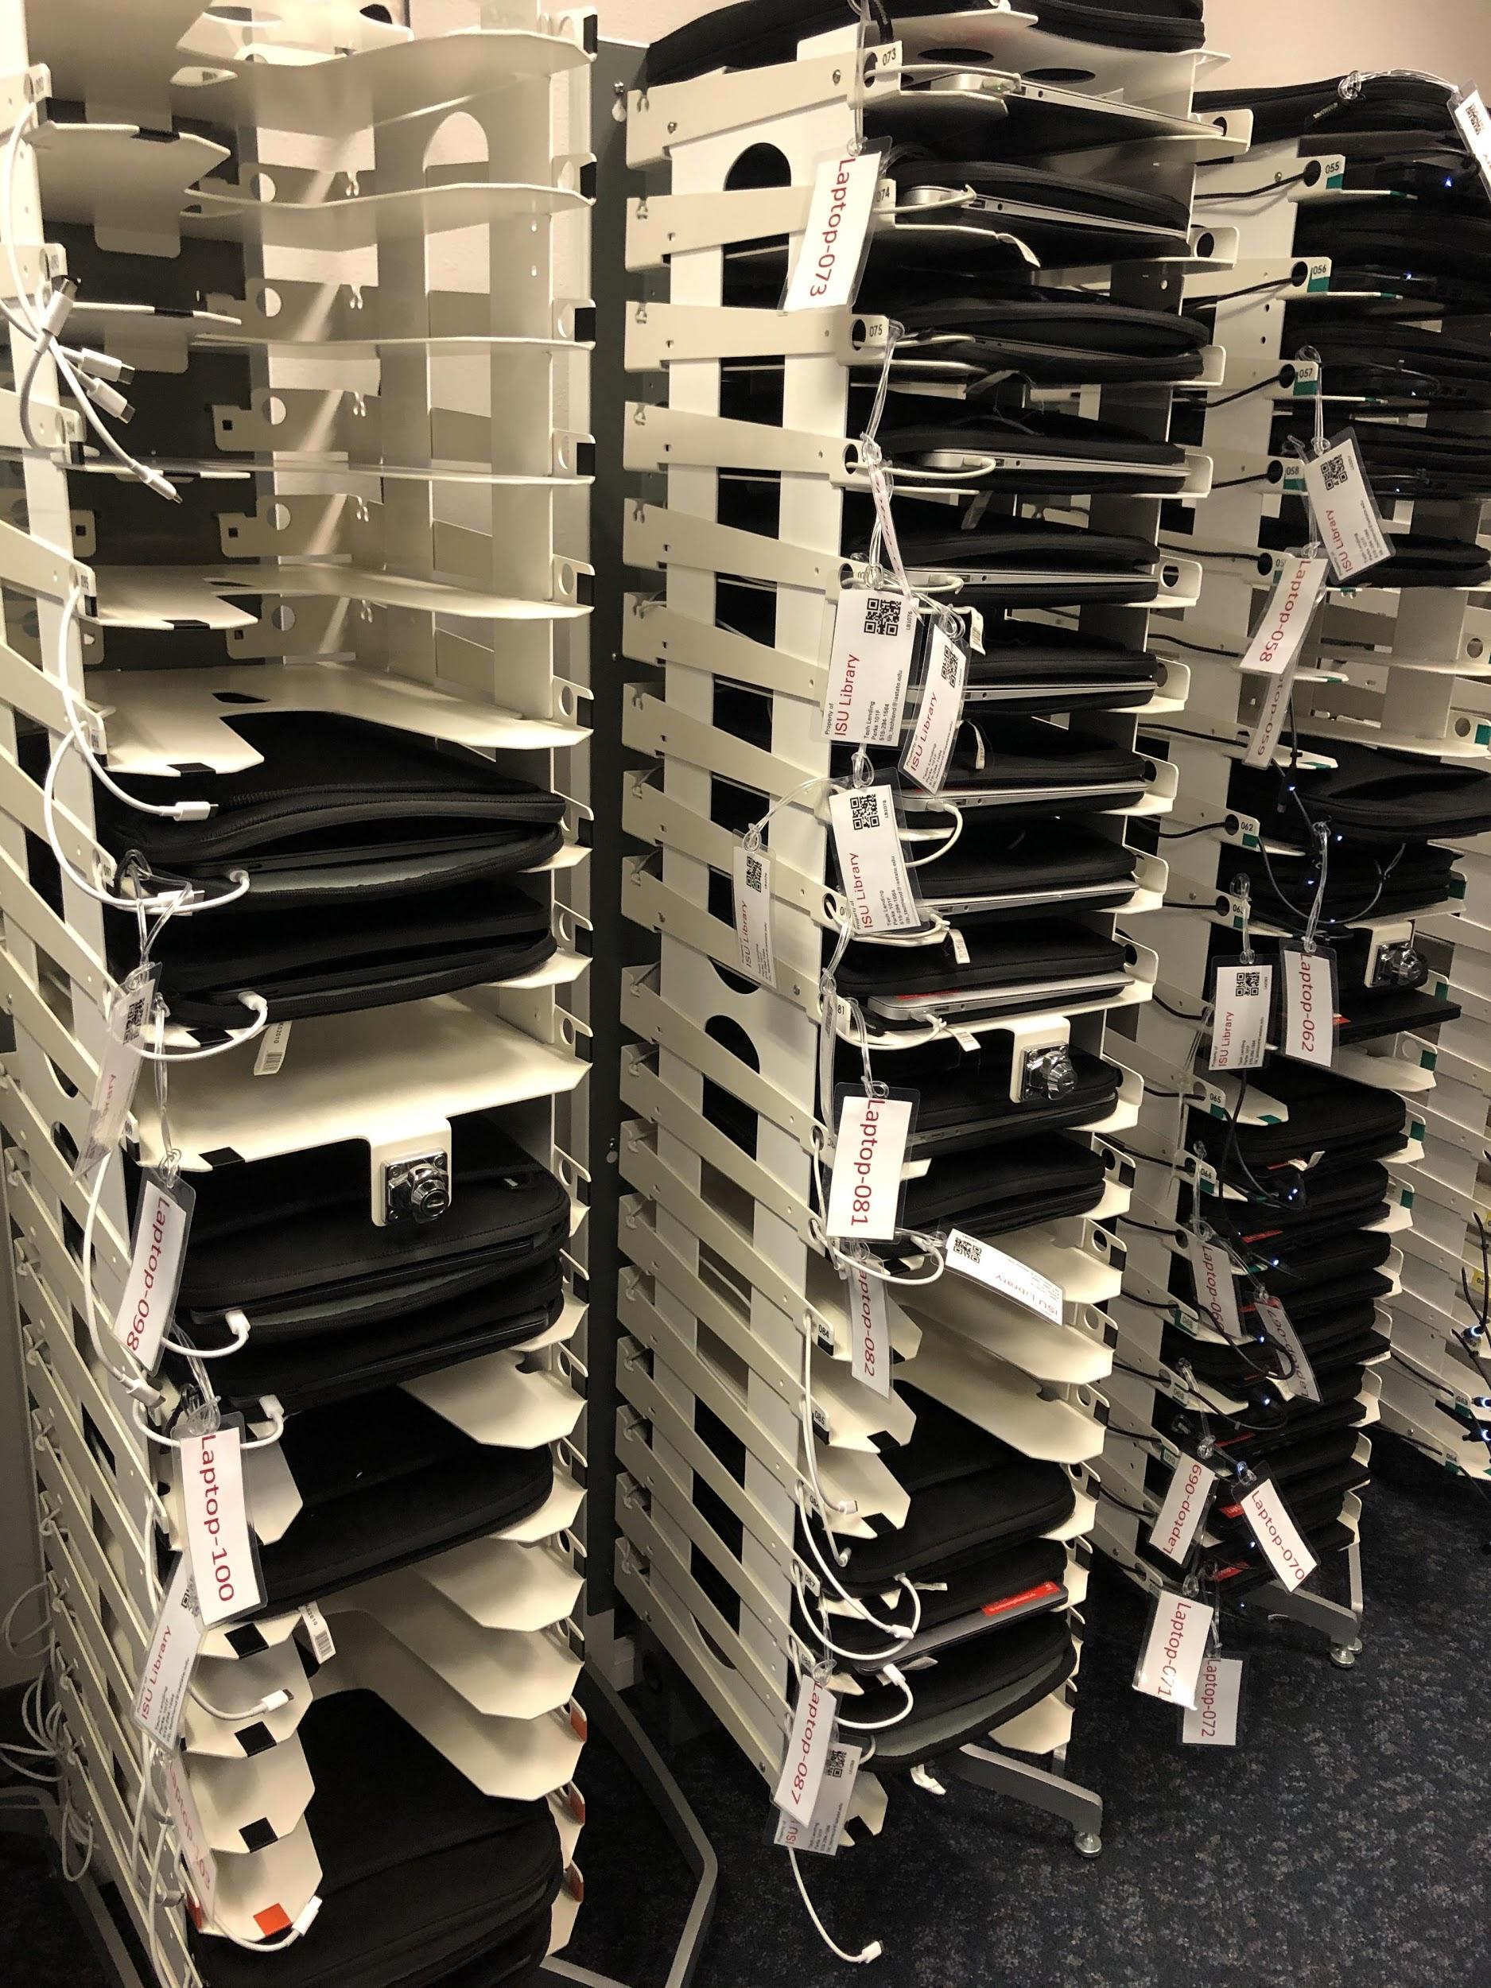
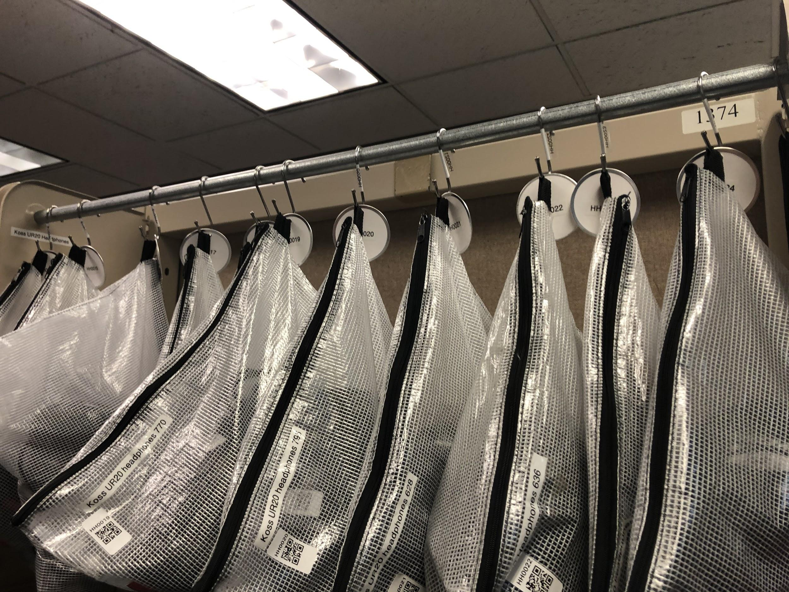
Project Overview
Parks Library Tech Lending Center lends over 200 devices to ISU student body
Devices displayed on racks as well as hung in bags on bars for employees to easily access.
Employees need way to know what the status of each device is (i.e., Checked Out, Overdue, etc).
Current System: Colored stickers to label status. Labels have to be manually replaced when statuses change.
Proposed new system: Color-changing LEDs corresponding to each device.
Given the proposed system, our team set out to create a scalable and user-friendly LED Status Display system for device racks and bars that...
Updates automatically with changes to device status.
Has a web-interface for adding new racks, bars and individual devices
Figure 1: Devices on Racks
Figure 2: Bagged devices on Bars

Slide 4
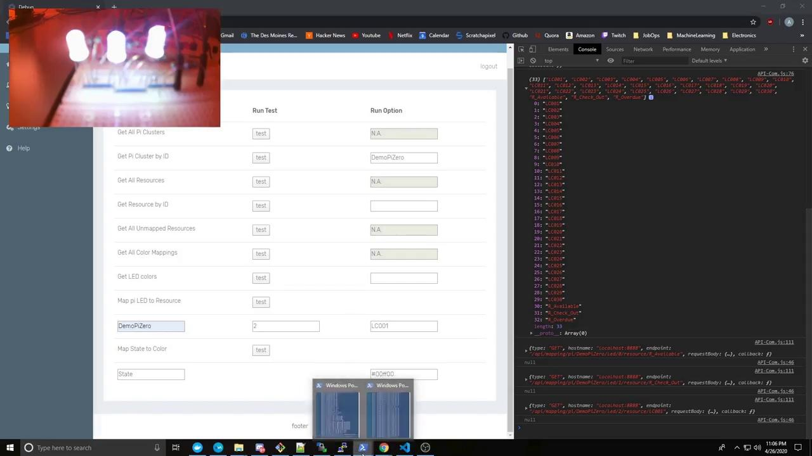
Demo
Sorry for the LED webcam quality!

Slide 5
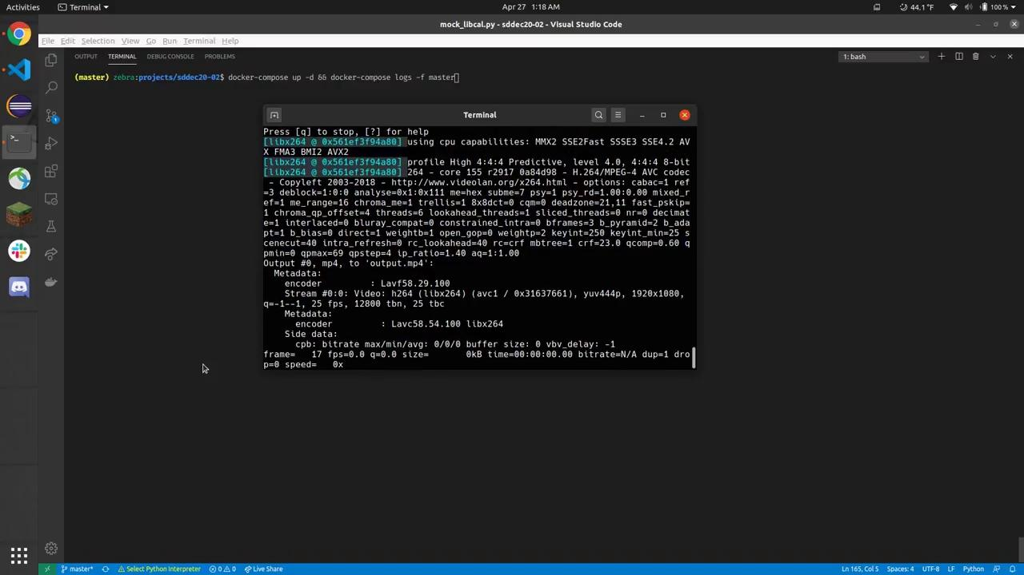
Demo 2

Slide 6
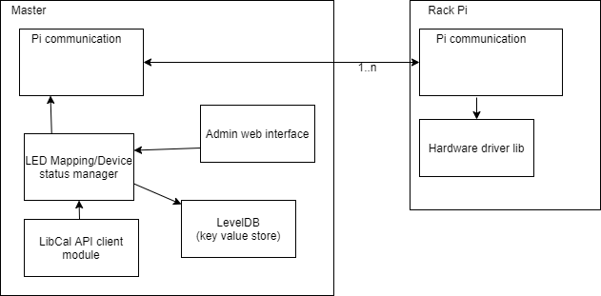
Software Architecture
Figure 3: Software Architecture

Slide 7
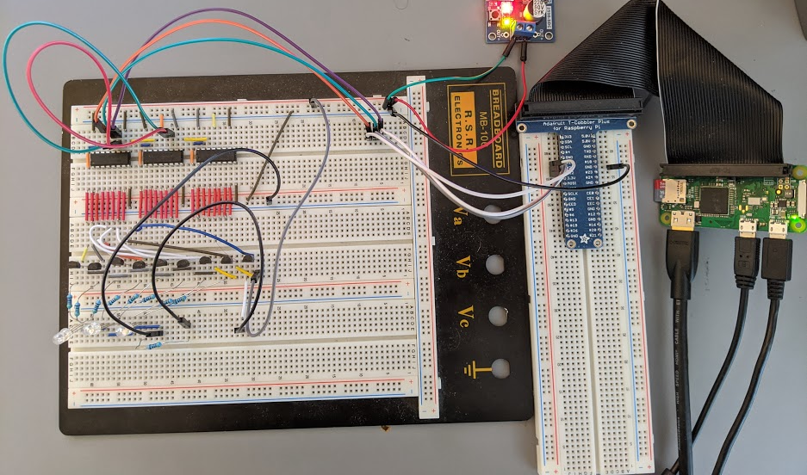
Hardware Architecture
Each addressable module consists of a Raspberry Pi Zero W and an LED driver circuit controlling between 24-50 RGB LEDs
Number of LEDs is dependent on application - density of storage for lending system items
Each Raspberry Pi communicates with the master server controlling the Pi network
Polls for updates to a range of LibCal identifiers
Makes call to LED driver library to update an LED by index
Many LEDs are driven through a series of daisy-chained shift registers
Shift registers control transistors connecting power to RGB LEDs
Controlled via 3 pins on a Raspberry Pi Zero
Separate power for driving LEDs
PWM control of LEDs is implemented via software driver to support a wider color range
Figure 4: Breadboard testing of driving circuit for rack-mounted LEDs

Slide 8
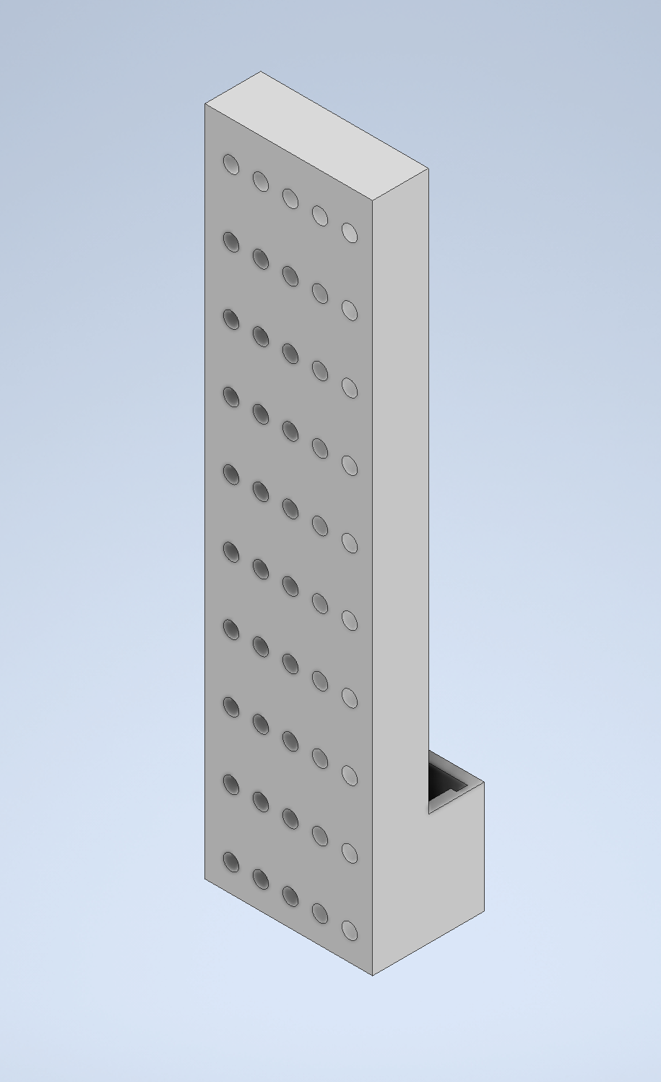
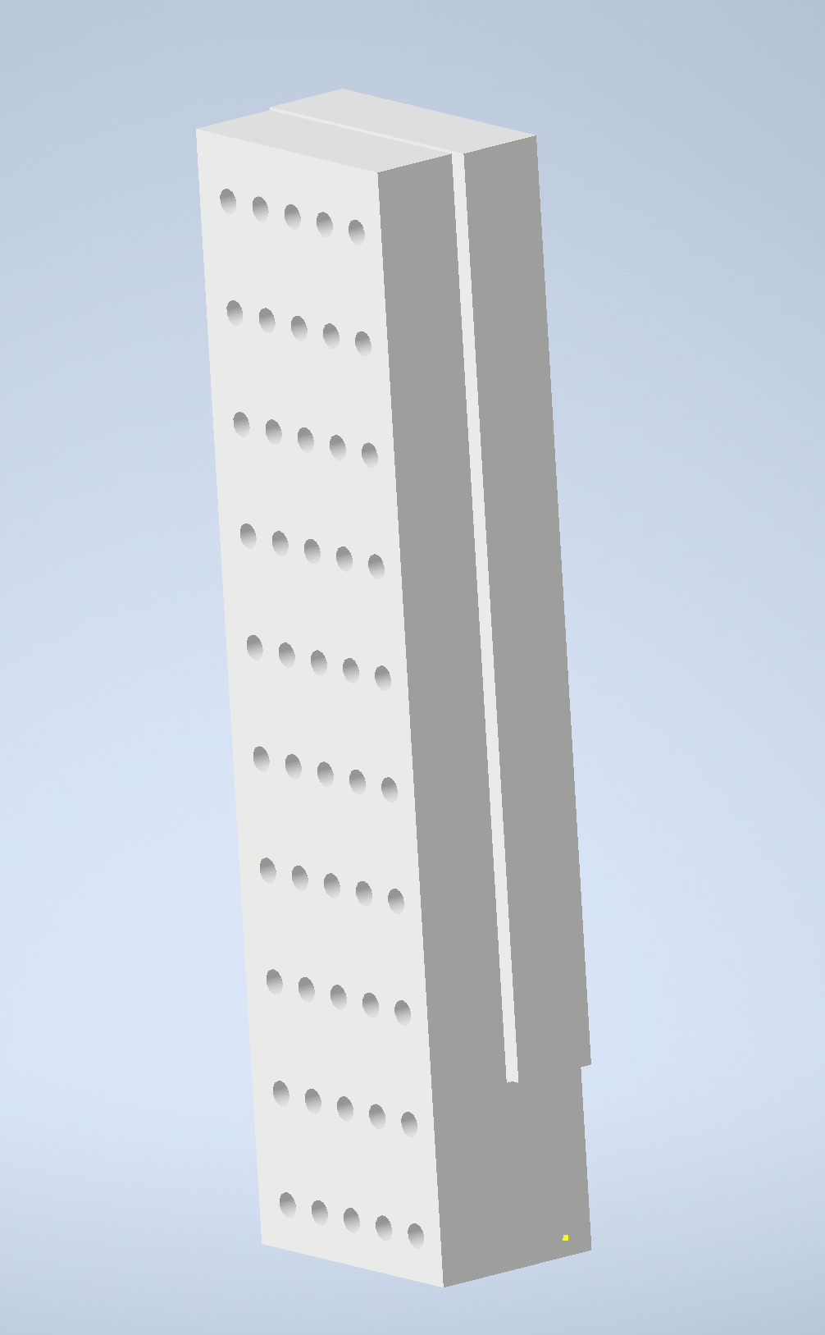
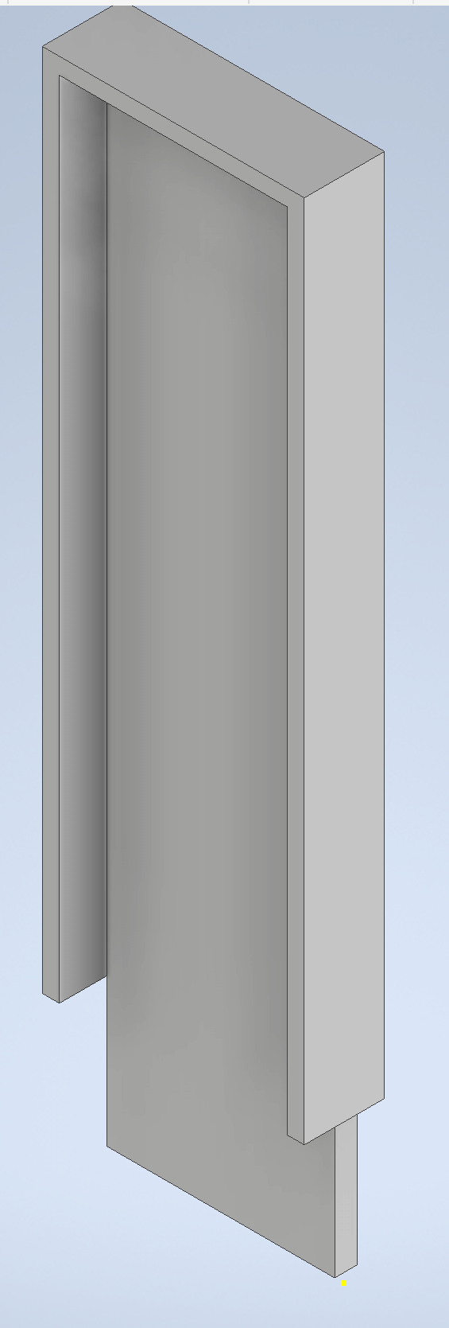
Bagged Device Solution: Original Design
Figure 5: Different views of case

Slide 9
Issues with first design
The labeling would not be able to fit.
The orientation, and attachment of the case.

Slide 10
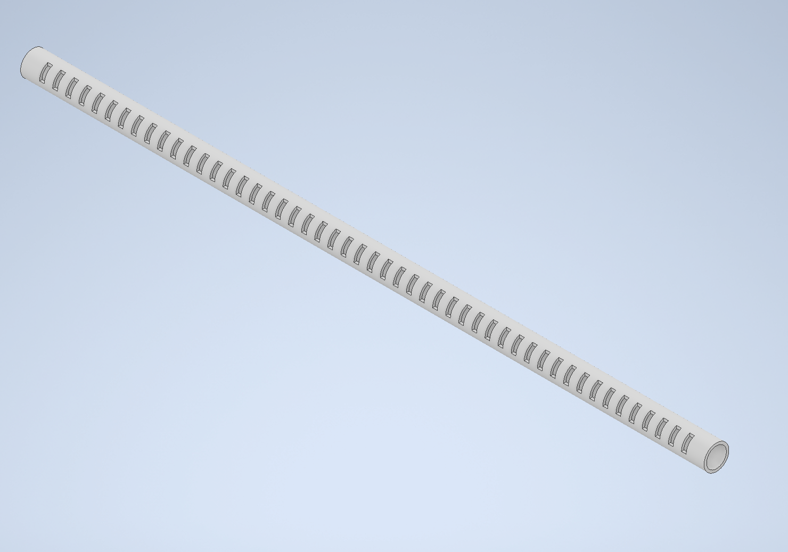
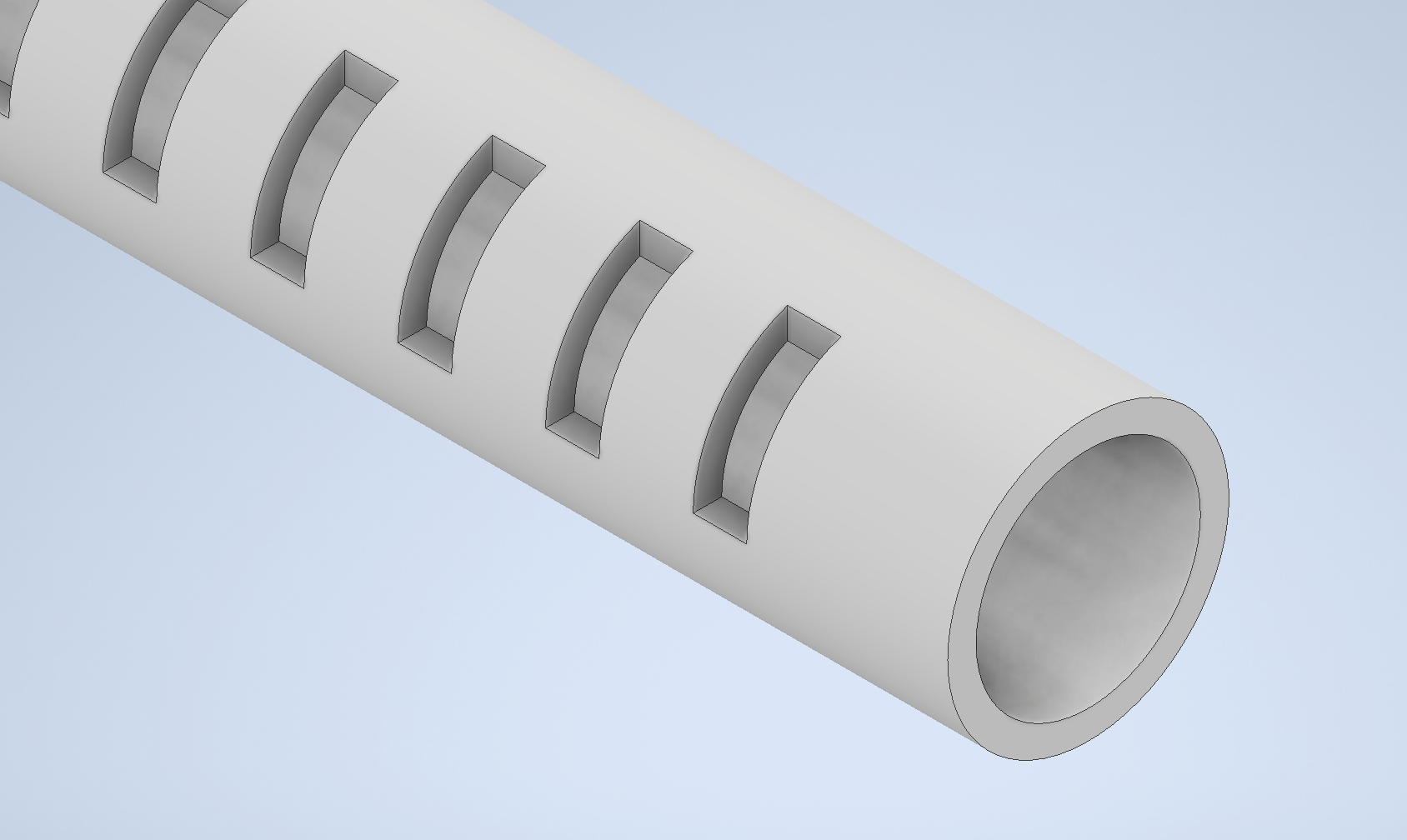
New Design:
Figure 6: New Design

Slide 11
How the new design fixes issues:
The labels can go in several orientations, vertical, horizontal, or diagonal.
This design can only be mounted and oriented, in one way.

Slide 12
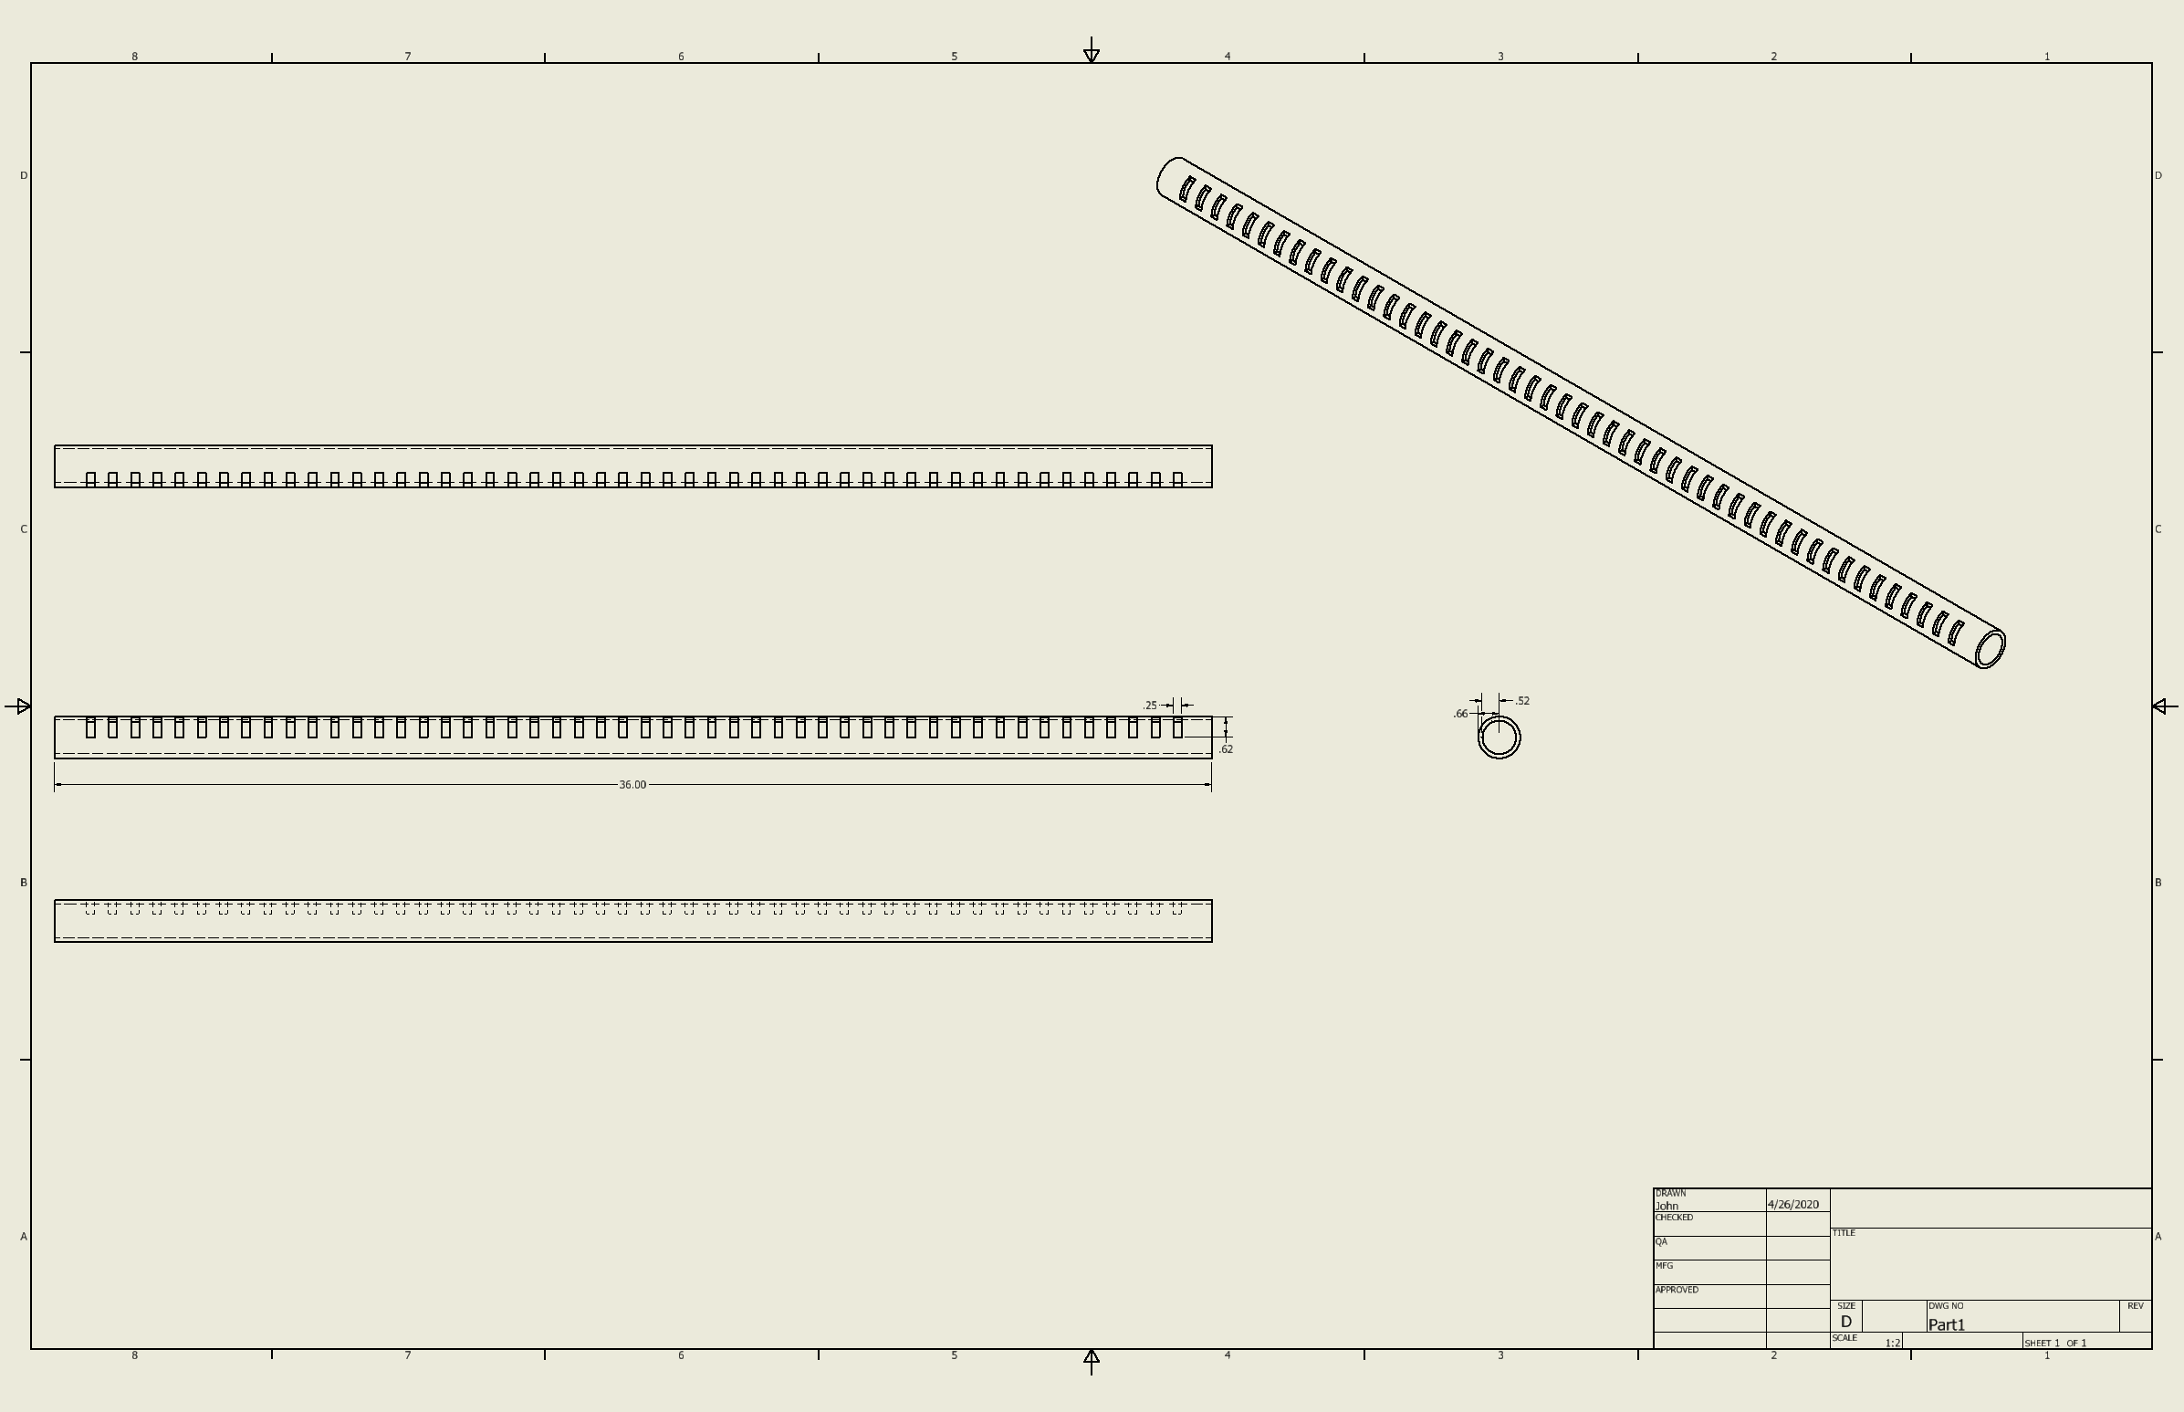
New Design Schematics:

Slide 13
What’s next (Hardware)
Further Development on Mounting Solution
Manufacture housing prototype
Rack Module
Bagged Item Module
Manufacture Printed Circuit Board for Housing Hardware Components
PCB design using Autodesk Eagle has begun
Aiming for early PCB manufacturing tests near the beginning of the fall semester
Change LED driver input method to SPI (Serial Peripheral Interface) from manually clocked pins
This switch will allow much quicker updating of the shift register values
Will free up CPU load by making use of on board SPI hardware on Raspberry Pi
Research alternative LED options
More aesthetically pleasing LEDs for final construction

Slide 14
What’s next (Software)
Get admin interface operational + added functionality
User option to blink Pi LEDs as a connection check
View Logs from Pis
Fix bugs
Fix Bugs showing up in Health checks
Optimize libcal api
Improve data fetching through multithreading
Build raspberry pi image
Install Rack Pi software on each Pi-Zero
Documentation
Refine Code documentation and expand GitLab Wiki
Create installation guide for Tech Lending employees

